Slide 1

Modeling Semantic Relations Expressed by Prepositions
Vivek Srikumar and Dan Roth
University of Illinois, Urbana-Champaign

Slide 2
Prepositions trigger relations
John enjoyed the visit to the zoo in NYC.
Enjoy
Agent/Enjoyer: John
Cause/Thing-enjoyed: the visit to the zoo in NYC
Visit
Agent: John
Destination: the zoo in NYC
Q: Where is the zoo located?
A: NYC.

Slide 3
Talk outline
Ontology of preposition relations
Two models for predicting preposition relations
Experiments

Slide 4
Ontology of Preposition Relations

Slide 5
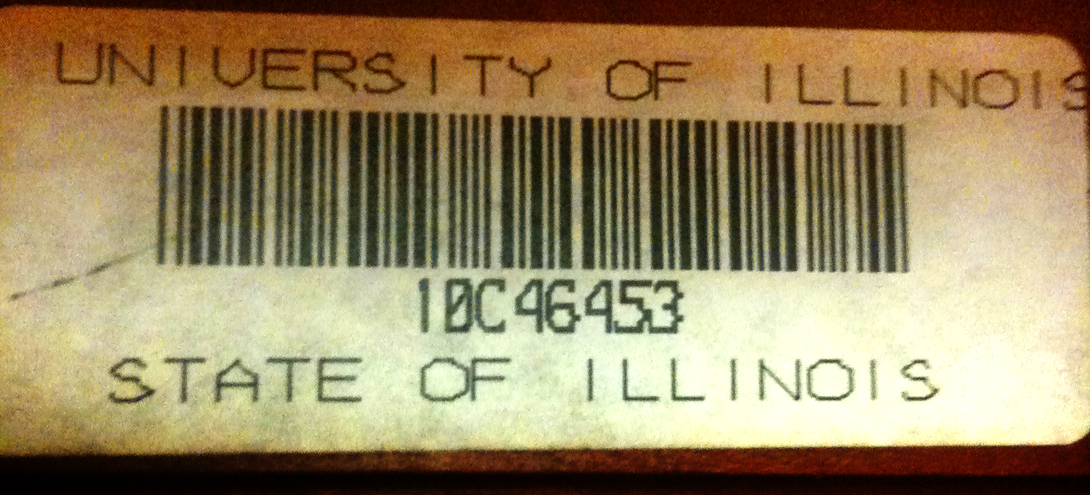
Examples of preposition relations
Possessor
Species

Slide 6
Preposition Sense Disambiguation
Eg. State of Illinois vs. University of Illinois
The Preposition Project [Litkowski and Hargraves, 2005]
Word sense for 34 prepositions
Based on preposition definitions in Oxford Dictionary of English

Slide 7
Mapping from senses to relations
live at Conway House
at:1(1)
Location
stopped at 9 PM
at:2(2)
drive at 50 mph
at:5(3)
Temporal
look at the watch
at:9(5)
Numeric
cooler in evening
in:3(2)
the camp on the island
on:7(2)
ObjectOfVerb
came on Sep. 26th
on:17(8)
.
.
.

Slide 8
An inventory of preposition relations
Labels that act as the predicate
Semantically related senses of prepositions merged
~250 senses ➔ 32 relation labels
Word sense disambiguation data, re-labeled
SemEval 2007 shared task gives relation labeled data
~16K training and ~8K test instances
34 prepositions

Slide 9
Two Models for Predicting Preposition Relations
“zoo in NYC”
Location(zoo, NYC)

Slide 10

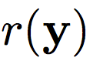
Structure of prepositions
Poor care led to her death from flu.
Relation
Cause
Governor
death
flu
Object

Slide 11
Relation depends on argument types
Poor care led to her death from flu.
Cause(death, flu)
Poor care led to her death from pneumonia.
How do we generalize the classifier to unseen arguments in the same “type”?

Slide 12
Why are types important?
Goes beyond words
Abstract flu and pneumonia into the same group
Some semantic relations hold only for certain types of entities
Two notions of type
WordNet hypernyms
Distributional word clusters
Allow for multiple meanings and concept hierarchies

Slide 13
WordNet IS-A hierarchy
^{pneumonia}
^{=> respiratory disease}
^{=> disease}
^{=> illness}
^{=> ill health}
^{=> pathological state}
^{=> physical condition}
^{=> condition}
^{=> state}
^{=> attribute}
^{=> abstraction}
^{=> entity}
Picking the right level in this hierarchy can generalize pneumonia and flu
More general, but less discrimniative
Picking incorrectly will over-generalize

Slide 14
Structure of prepositions
Poor care led to her death from flu.
Relation
Cause
Governor
death
flu
Object
Governor type
experience
disease
Object type

Slide 15
Two models
Model 1
Predict only relation label: Multi-class
Use features from all possible governor and object candidates
Also types
Model 2 uses features from the structure
Predict full structure: relation and arguments
Also types

Slide 16
Model 1: Predict relation label
Poor care led to her death from flu.
Attribute
Paint from resin
Relation
Cause
Weak from asthma
Source
Candidate from Montreal
.
.
Governor
led
Object
Features from all sources
her
flu
death
Governor type
Object type
lead
her
contagious disease
change in state
killing
produce
communicable disease
event
point in time
travel
disease
state
ending

Slide 17
Model 2: Predict full structure
Governor type
Poor care led to her death from flu.
Attribute
Paint from resin
Cause
Weak from asthma
Relation
Source
Candidate from Montreal
.
.
Governor
led
Object
her
flu
death
Governor type
Object type
lead
her
contagious disease
change in state
killing
produce
communicable disease
event
point in time
travel
disease
state
ending

Slide 18
Structure of prepositions
Poor care led to her death from flu.
Relation
Cause
Governor
death
flu
Object
Governor type
experience
disease
Object type

Slide 19
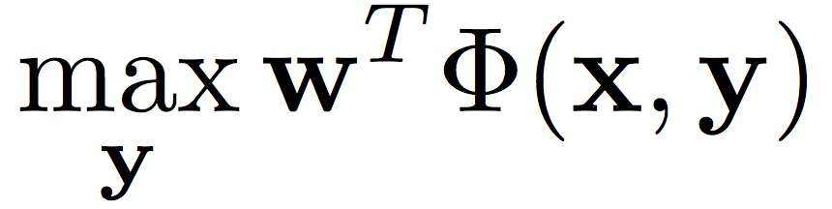

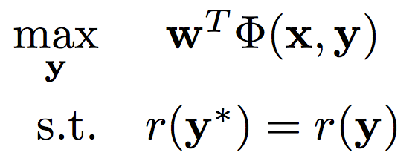
Learning Model 2: Latent inference
Standard inference: Find an assignment to the full structure
Latent inference: Given an example with annotated
“Complete the structure given current model”

Slide 20
Learning Model 2
Initialize weight vector using Model 1
Repeat
Use latent inference with current weight to “complete” all missing pieces
Train with Structured SVM
During training, the learning algorithm is penalized more if it makes a mistake on
Generalization of Latent Structure SVM [Yu & Joachims ’09]

Slide 21
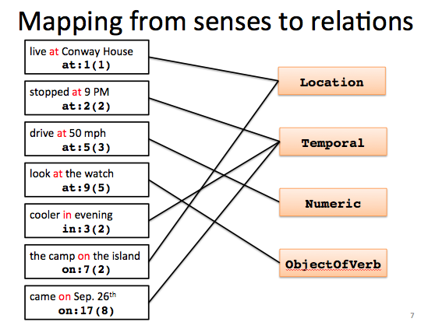
Preposition Sense and Relations
Poor care led to her death from flu.
Sense [Hovy et al, 2010]
Relation
Cause
from:12(9)
Governor
death
flu
Object
Governor type
experience
disease
Object type

Slide 22
Experiments

Slide 23
Accuracy of relation labeling
Model size: 5.41 million non-zero weights
Model size: 2.21 million non-zero weights
Model 2 helps
Enforcing coherence with preposition sense gives best results
Using types gives improvement, helps model 1 more

Slide 24
What do we have?
Input | Relation | Governor type | Object type
Died of pneumonia | Cause | Experience | Disease
Suffering from flu | Cause | Experience | Disease
Recovered from flu | StartState | Change | Disease
Governor, object and their types as a certificate for the choice of relation label

Slide 25
Conclusion
Prepositions express a diverse set of relations
An ontology of preposition relations
Can enrich existing PropBank/FrameNet representation
Models for predicting preposition relations
Arguments and types help
Data, word clusters, software available (soon)
Questions?

